Slide 1
Data gathering tool in Google maps
Team Name: 80n5ur3
Team Member: Umesh.B
Theme: Analytics

Slide 2
What is the IDEA/ Problem Statement ?
In case of a small scale business a supplier will require Data of buyers in-order to approach them.
For example: A vegetable seller who wants to increase his/her business will require data of buyers i.e., Department stores, to proceed. And if a seller want to supply clothing to a reseller/buyer.
Hence this tool helps develop business. The idea purely based on development of small scale businesses.

Slide 3
How are we going to implement our IDEA ?
The tool works like a web scraper, gathering all the data present in Google maps about a particular area, which the user defines.
The tool is scalable where if the user doesn’t know anything about web scraping can handle. The setup part is explained in detail inside the project files.
And the tool after setup works with a single click, with 100% accuracy and provides the details in a text file.

Slide 4
Technology used?
The Programming Language used – Python
Download Link: https://www.python.org/downloads/
Setup Instructions: https://datatofish.com/add-python-to-windows-path/
Frameworks used –
Pyperclip – Used in copy paste of data to file.
Open CMD and paste pip install pyperclip
Detailed Instructions: https://pypi.org/project/pyperclip/
Selenium - Used in web automation.
Open CMD and paste pip install selenium
Detailed Instructions: https://pypi.org/project/selenium/

Slide 5
How much of the project is done?
The project is completely working with 100% accuracy, which is in the sense it will not miss any data, and works without crashes.
Exception handling is also implemented so in case of any errors the program will stop notifying the user about the error.
The working of the project is also tested in Linux Environment, works on all Operating systems.
Using chrome debug tools will drastically increase the execution time because DevMode Chrome has no extensions to depend on.

Slide 6
Future Plans ?
The tool can be implemented as GUI which reduces the complexity even more.
The data gathered can be stored inside .xls file or .cxv file, for further automation.

Slide 7
Business Model or Open source program ?
This project aimed to be Open source program keeping in mind that small scale businesses cannot afford to pay premiums for programs.
Making the project Open source will provoke most people to use the product.

Slide 8
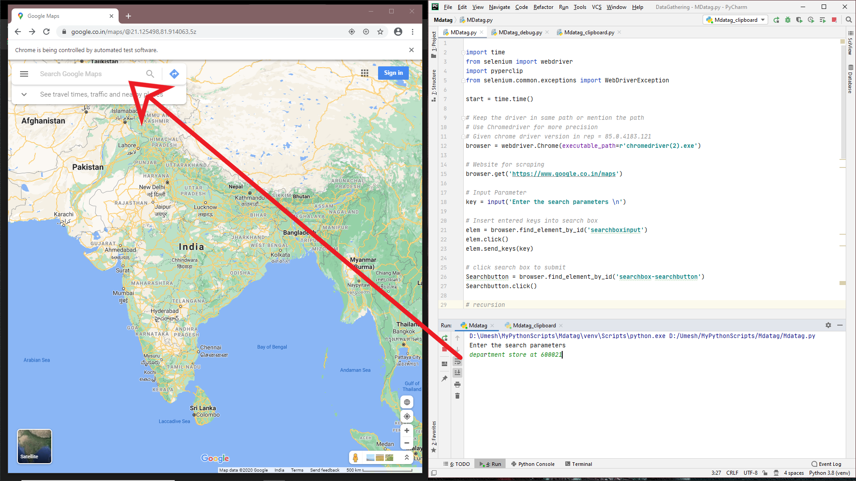
Demo/Screenshots of the product

Slide 9
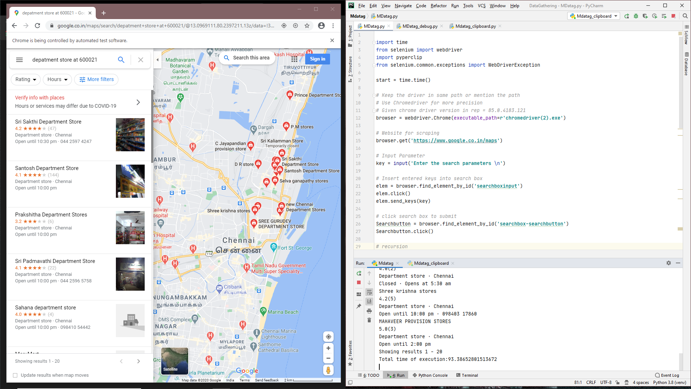

Slide 10
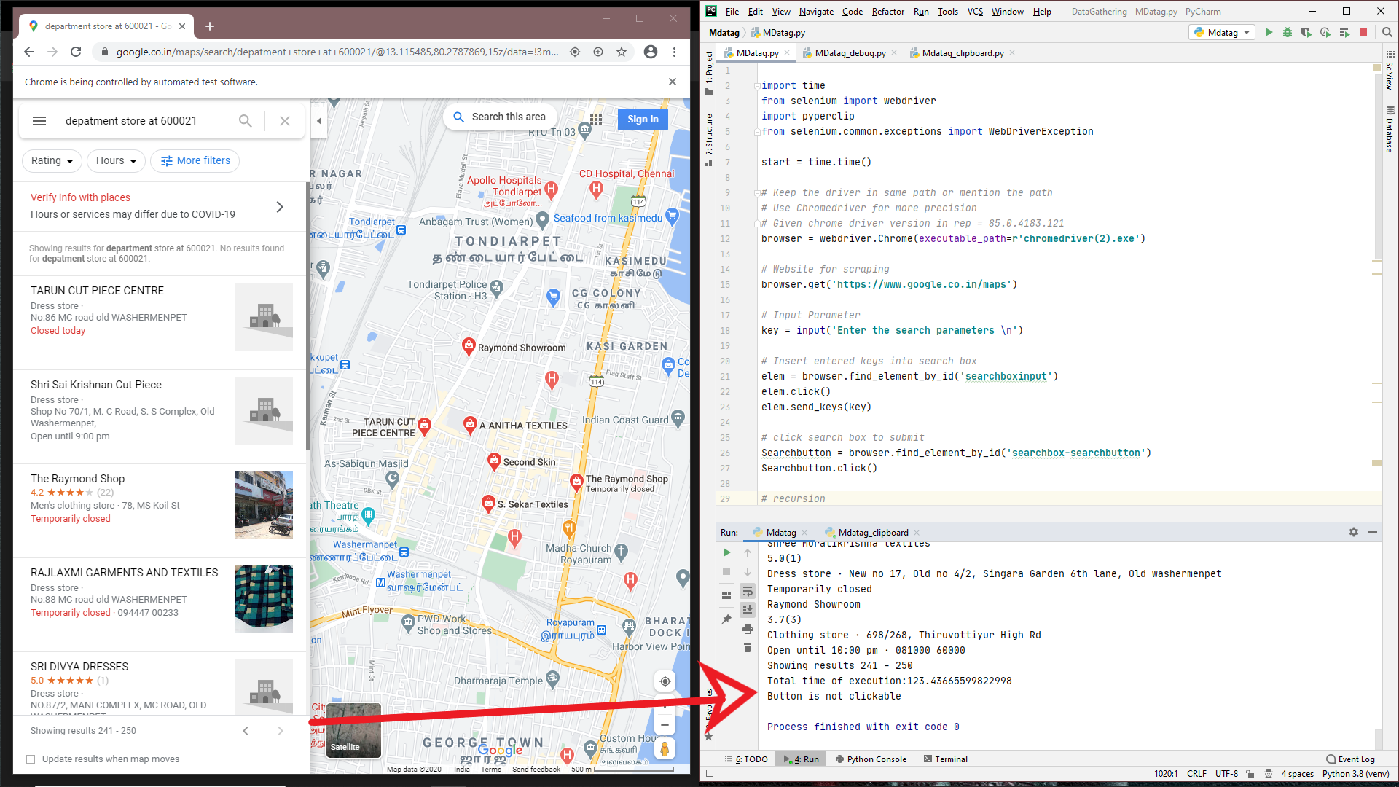

Slide 11
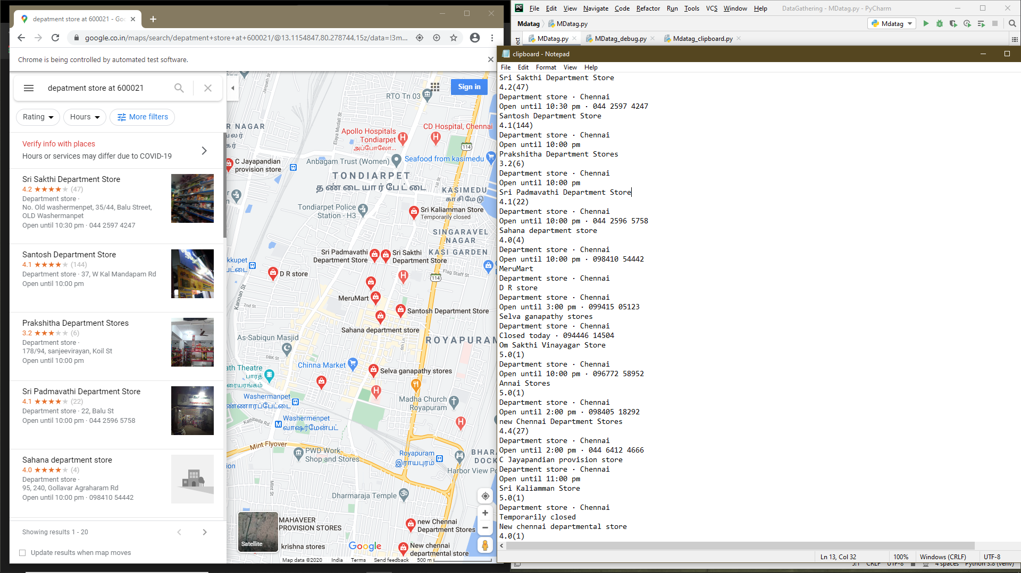

Slide 12
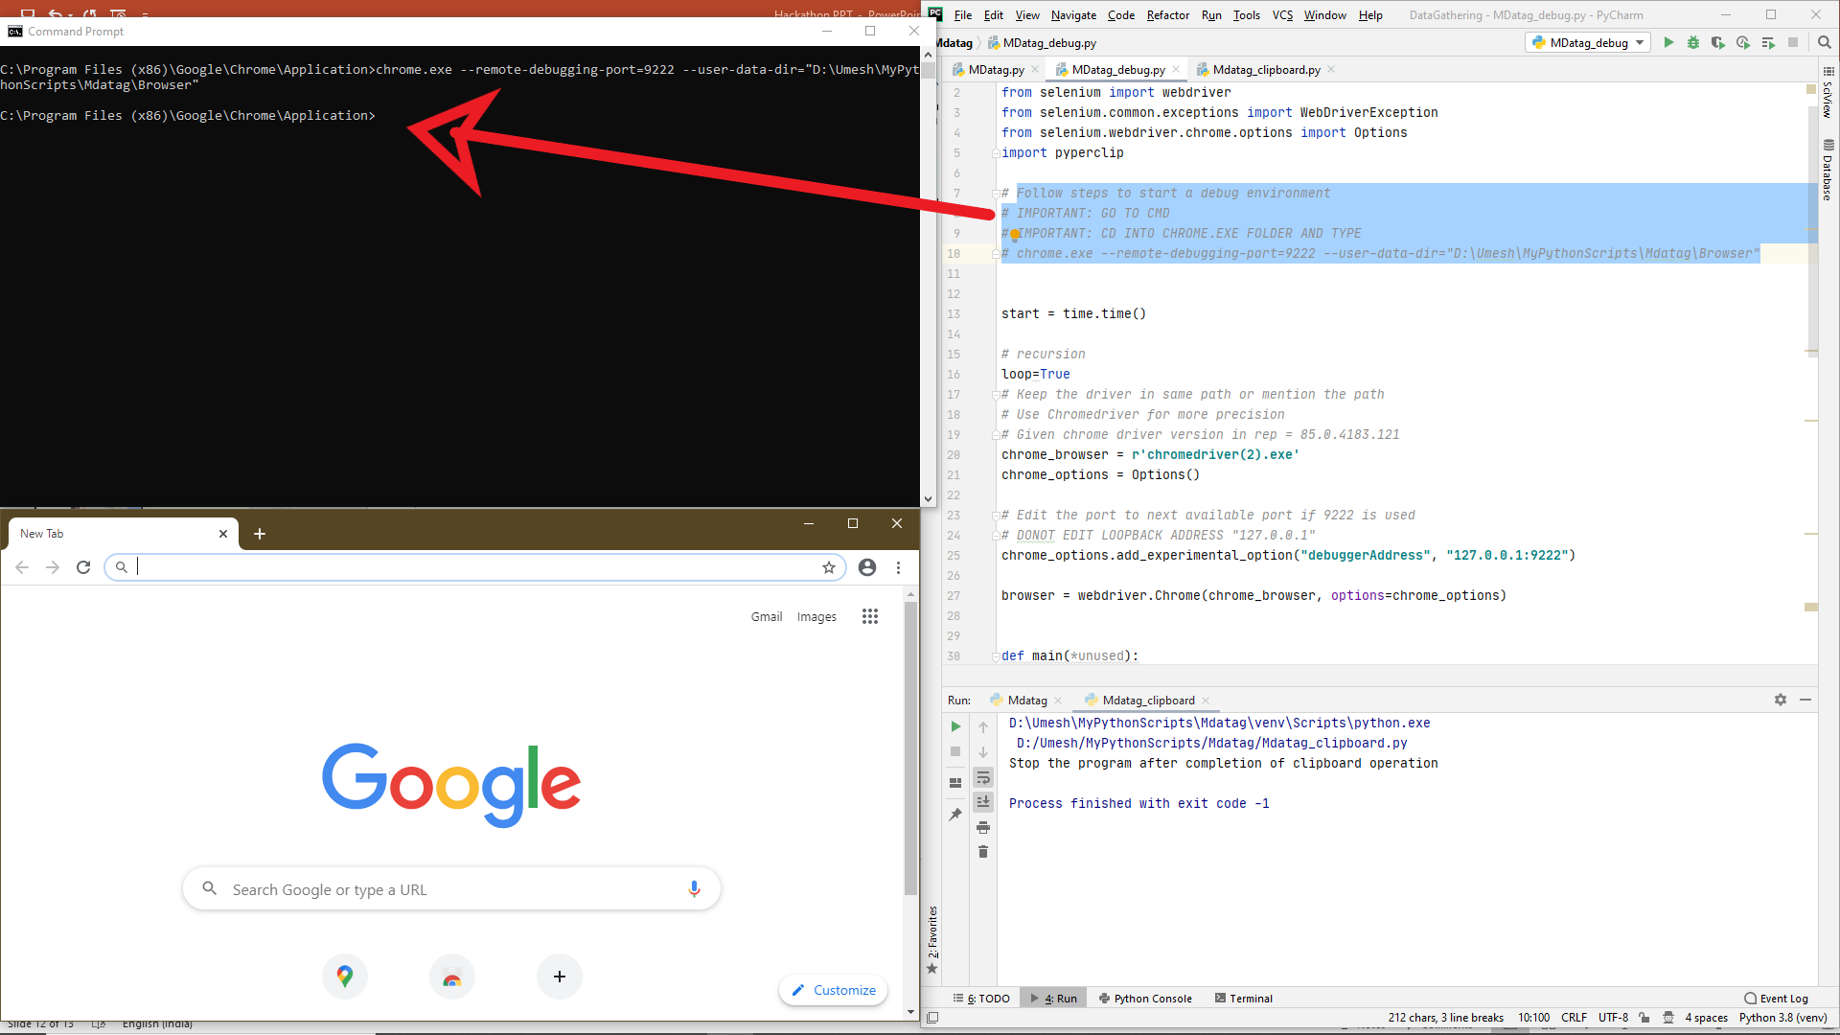
Added functionality to user where they can use chrome debug environment

Slide 13
Thank you
Project submitted to Let’s Upgrade Hackathon (HWLU).
- Regards Umesh. B

